Slide 1

Iot Core
Get requests
Internet Browser

Slide 2
Content
Set IP address of IoT port
Iot
Example 1: Get tree
Example 2: Get input process data

Slide 3
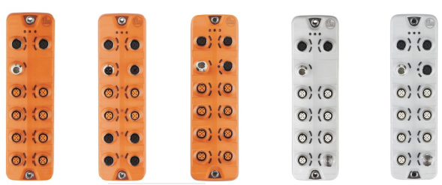

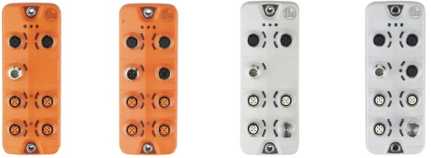
Set IP Address of Iot port
To set the IP address of the IoT port use Ethernet Device Configuration Tool
Ethernet Device Configuration Tool is free of charge software that is only used to set the IP address of the IO-Link module

Slide 4
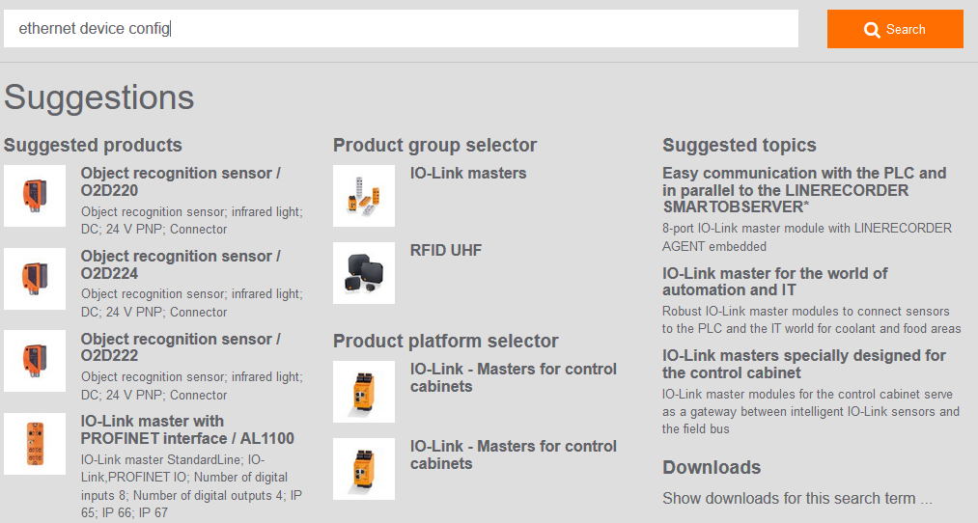
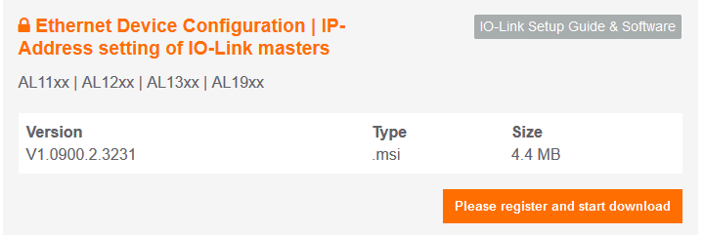
Set IP Address of Iot port
1. Go to the ifm global website, select your country.
2. Text search “Ethernet device config” to find the Ethernet Device Configuration Tool.
3. Click Show Downloads for this search term…
4. Download the Ethernet Device Configuration software found in the search results.
Note: A “my ifm” account must be created and logged in before downloading. Follow the prompts to create a “my ifm” account.

Slide 5
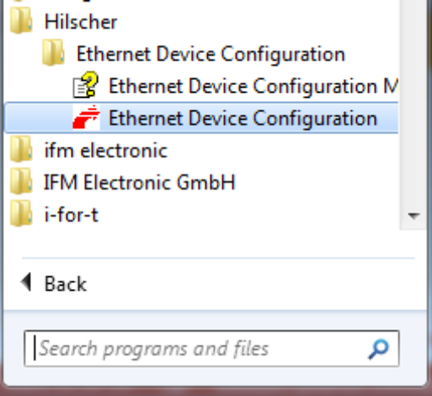
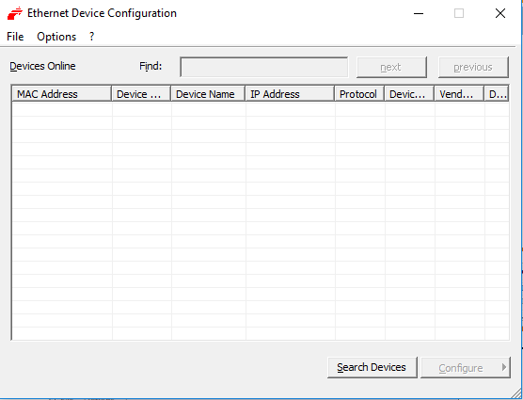
Set IP Address of Iot port
5. Install and Start the Ethernet Device Configuration software by going to Start-Hilscher-Ethernet Device Configuration
6. Connect the Ethernet cable to the Iot port and click Search Devices to find the IO-Link modules connected to the PC

Slide 6
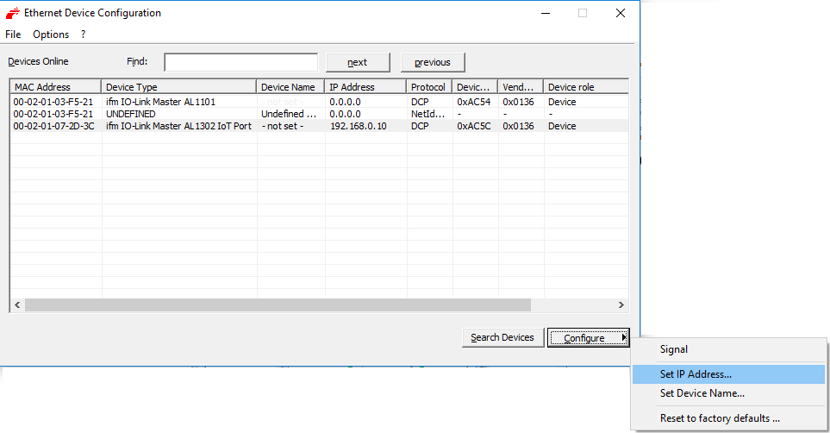
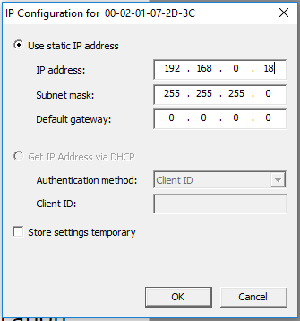
Set IP Address of Iot port
7. To change the IP address, select the IO-Link master found in the list.
8. Click Configure-Set IP address and enter the IP address and subnet Mask
9. Verify that the new IP address of the IO-Link module has been set by clicking the Search Devices button again.

Slide 7
Iot Core
Ifm IoT Core is the face of a device
The IoT core is the representation of the functionality of a device.
IoT Core
Description in a structured tree of elements, where each element typed service, data, event structure with a device element at the root of the structure.

Slide 8
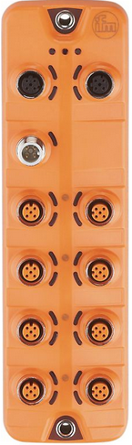
Iot Core
device
gettree
/gettree
getIdentity
/getidentity
processdatamaster
temperature
getdata
/processdatamaster/temperature/getdata
iolinkmaster
Port[1]
iolinkdevice
pdin
getdata
/iolinkmaster/port[1]/pdin/getdata
pdout
getdata
Port[2]
setdata
iolinkdevice
structure
pdin
data
getdata
/iolinkmaster/port[2]/pdin/getdata
service
In this tree structure each element can be addressed by an address build from the tree.

Slide 9
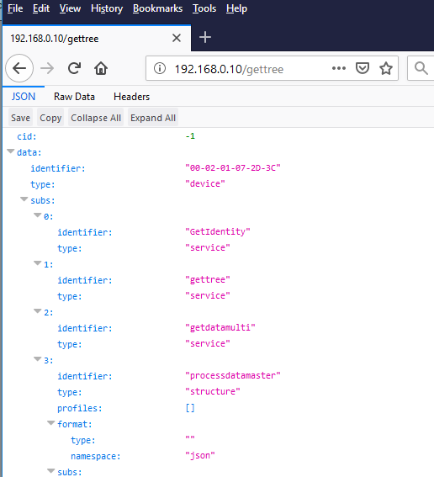
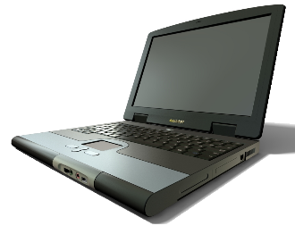
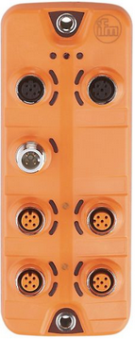
Example 1: Get tree
Example 1: Get tree
Connect the Iot port of the IO-Link Master to a Laptop/PC
Set the IP Address of IoT port e.g 192.168.0.10 (same subnet like network card)
Open a browser e.g Firefox Browser
install the jsonView https://addons.mozilla.org/de/firefox/addon/jsonview/
Enter http://192.168.0.10/gettree
IO-Link Master
with IoT port
Laptop / PC

Slide 10
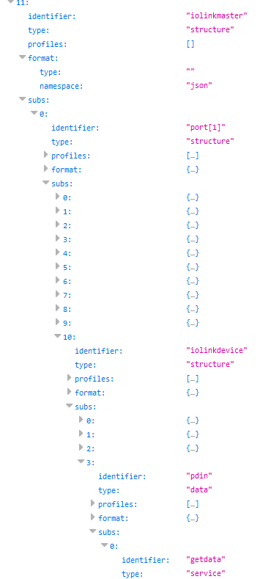
Example 2: Get input process data
Example 2:
Get the input process data of a connected device on port 1.
  Connect an IO-Link device to port 1
  (e.g Photoelectric distance sensor of ifm O5D150)
  With help of gettree shown in Example 1 build the address of the data:
/iolinkmaster/port[1]/iolinkdevice/pdin/getdata

Slide 11
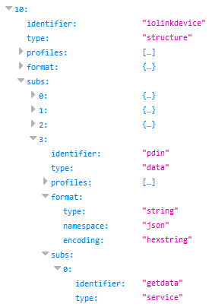
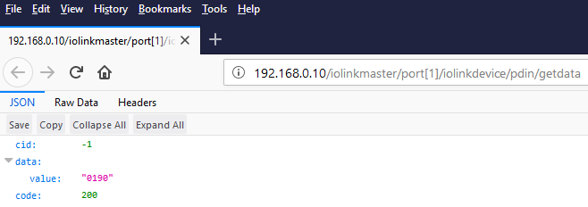
Example 2: Get input process data
3. Enter in Browser
http://192.168.0.10/iolinkmaster/port[1]/iolinkdevice/pdin/getdata
Return Value (e.g Photoelectric distance sensor of ifm O5D150):
Process data encoding in hexstring
from connected device on port 1

Slide 12

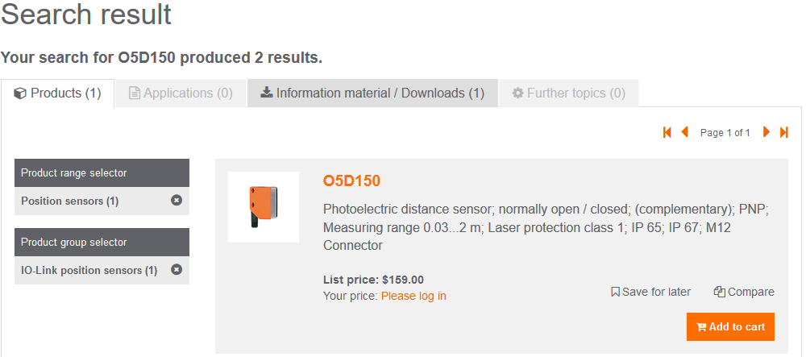
Example 2: Get input process data
4. To interpret the input process data from a connected IO-Link device
use the “IO Device Description pdf.”
  a. For ifm devices go to the ifm global website
  b. Text search the IO-Link device’s article number and click the button.
  c. Click the article number in the search results to go to the datasheet.
Example: O5D150

Slide 13
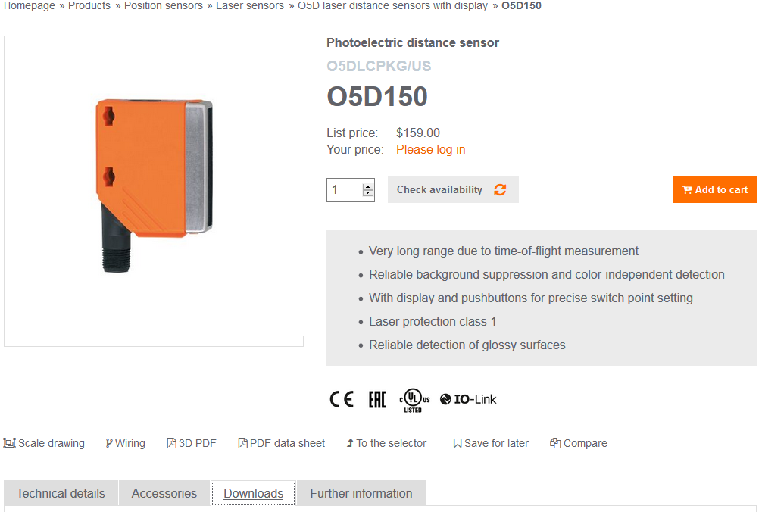
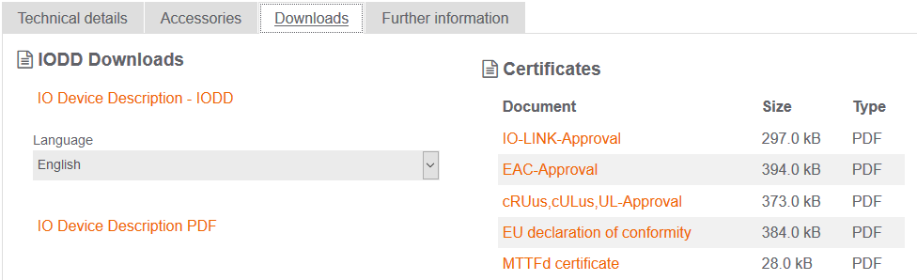
Example 2: Get input process data
d. From the datasheet click Downloads
e. Scroll down through the downloads to find the IO Device Description PDF

Slide 14
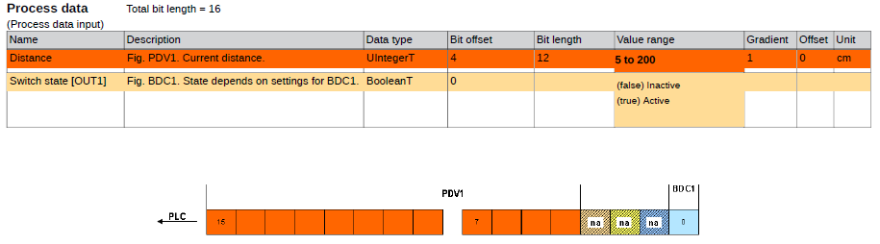
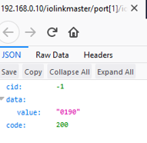
Example 2: Get input process data
5. View the IO Device Description pdf file. The cyclic data from the device is shown:
Input Process Data, units of measure and gradient.
Shift by 4 (devide by 16)
Convert the hex value to decimal
Hexstring „0190“ = 400 dec
400/16 = 25cm
25cm is the real process value interpreted from
the given Gradient and Unit of measure from the
O5D150‘s IO Device Description

